Slide 1
Citi Bike Data Analysis
By Anusha Hublikar

Slide 2
Project Goal:
To better understand the behavior of Citi Bike’s customer base (both one-time users and subscribers) and how they use Citi Bikes
This will help us to:
  Identify where more bikes should be installed
  Create targeted marketing campaigns that will appeal to different customer segments

Slide 3
Key questions:
What are the most popular pick-up locations across the city for Citi Bike rental?
How does the average trip duration vary across different age groups?
Which age group rents the most bikes?
How does bike rental vary across the two user groups (one-time users vs long-term subscribers) on different days of the week?
Does the factor of user age impact the average bike trip duration?

Slide 4
Findings & Insights

Slide 5
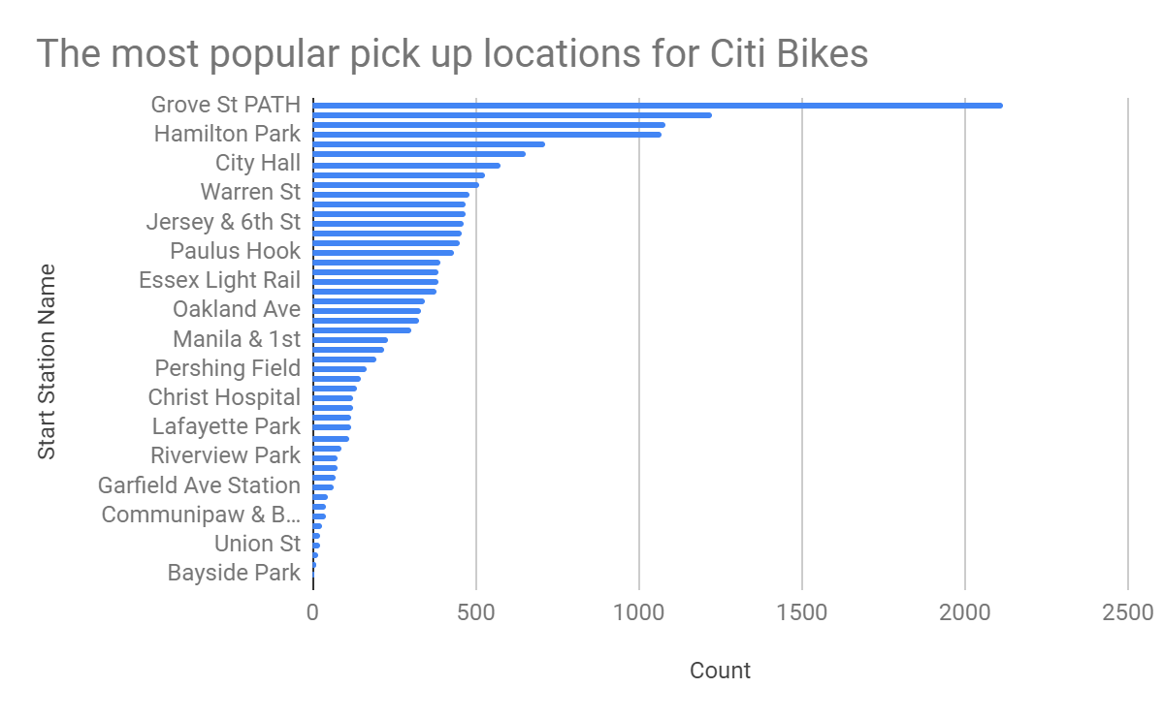
What are the most popular Citi Bike pick-up locations?

Slide 6
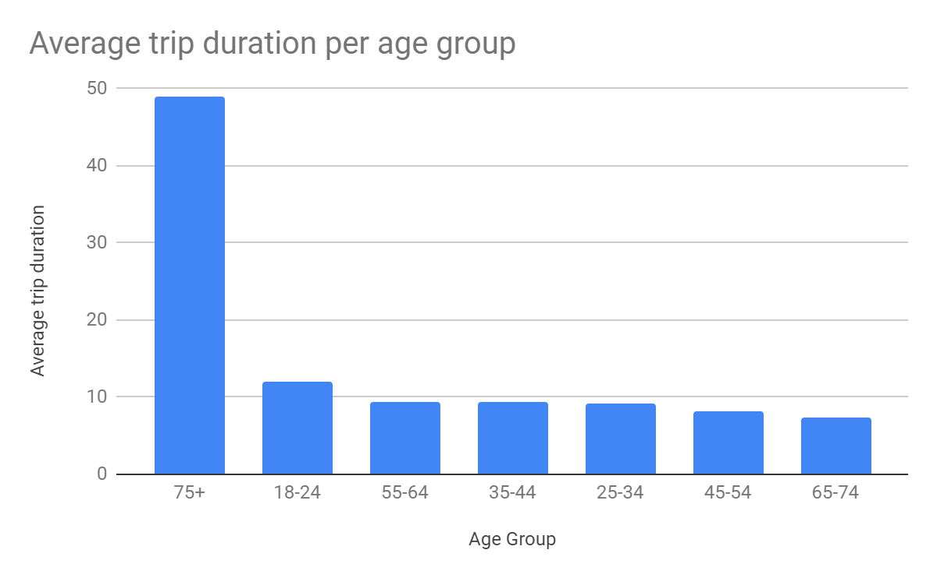
2. How does the average trip duration vary across different age groups?
Average trip duration for 75+ years old is longest
Average trip duration for 65-74 age group is shortest

Slide 7
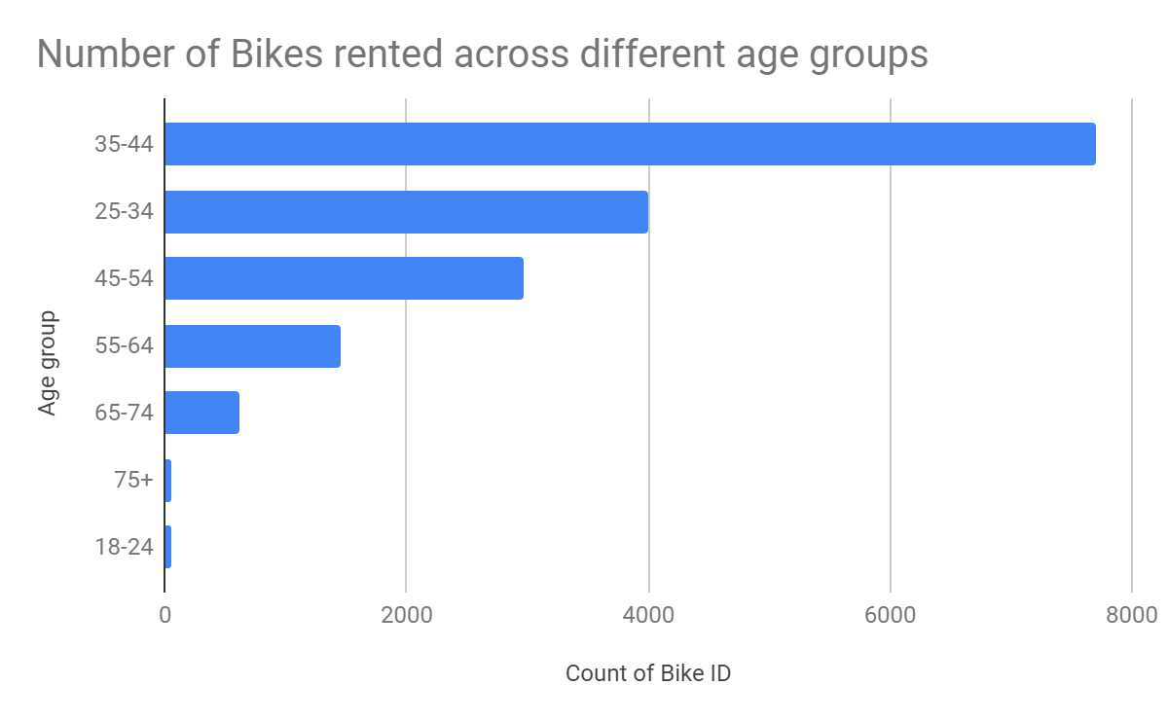
3. Which age group rents the most bikes?
Age group of 35-44 rents most number of bikes in the city
Age group of 18-24 has the least count

Slide 8
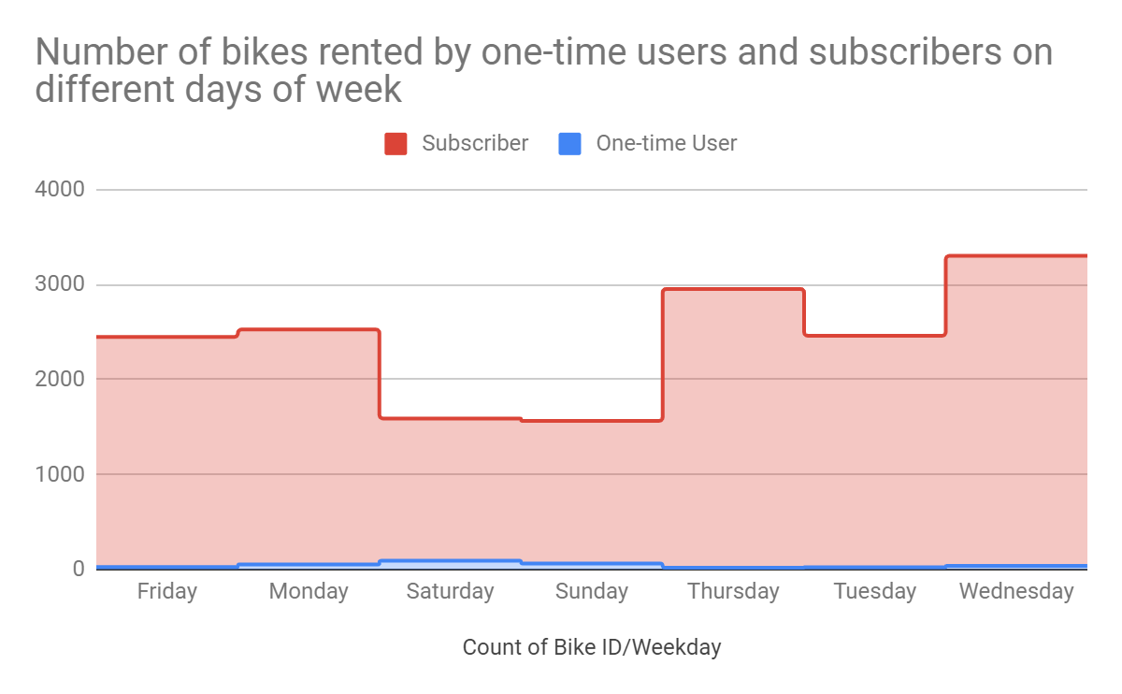
4. How does bike rental vary across the two user groups (one-time users vs long-term subscribers) on different days of the week?
Citi Bike customer base is predominantly made up of long term subscribers
Subscribers are more active on weekdays
One time users are active on weekends

Slide 9
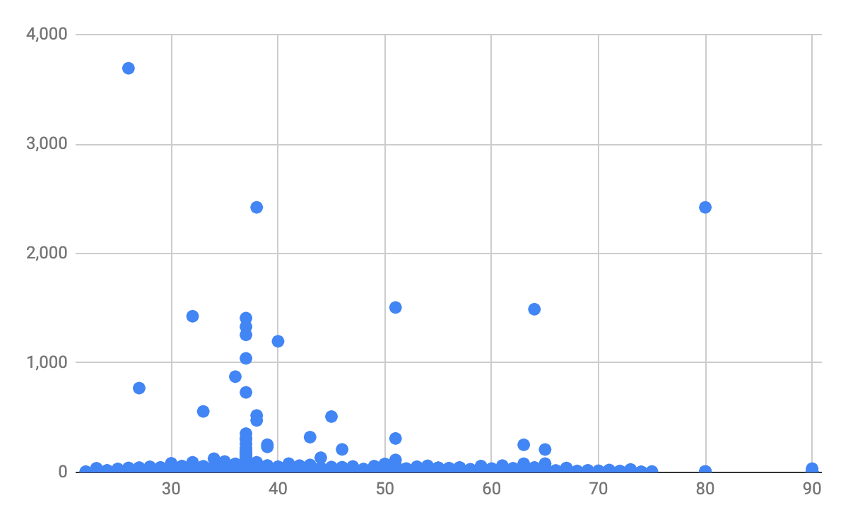
5. Do factors like weather and age impact the average bike trip duration?
No relationship between user age and trip duration

Slide 10
Summary

Slide 11
Summary of findings:
Top 5 pick-up locations for bikes:
  Grove St Path, Exchange Place, Sip Ave, Hamilton Park, & Morris Canal
Customer base:
  Age group of 35-44 rents most number of bikes in the city
  Citi Bike customer base is predominantly made up of long term subscribers
Citi Bike customer behavior:
  Age group of 75+ takes longest hours to complete the ride
  Age group of 65-74 takes less hours to complete the ride

Slide 12
Actions & Recommendations

Slide 13
Recommended actions:
Product recommendations:
Grove St Path, Exchange Place, Sip Ave, Hamilton Park, & Morris Canal
Marketing recommendations:
The Citi Bike customer base is mostly long term subscribers aged between.35-44, who are most active weekdays This tells us that they are probably people who live in New York and use Citi Bikes to commute. Marketing and advertising campaigns should therefore target this particular demographic.

Slide 14
Thank you!

